Slide 1
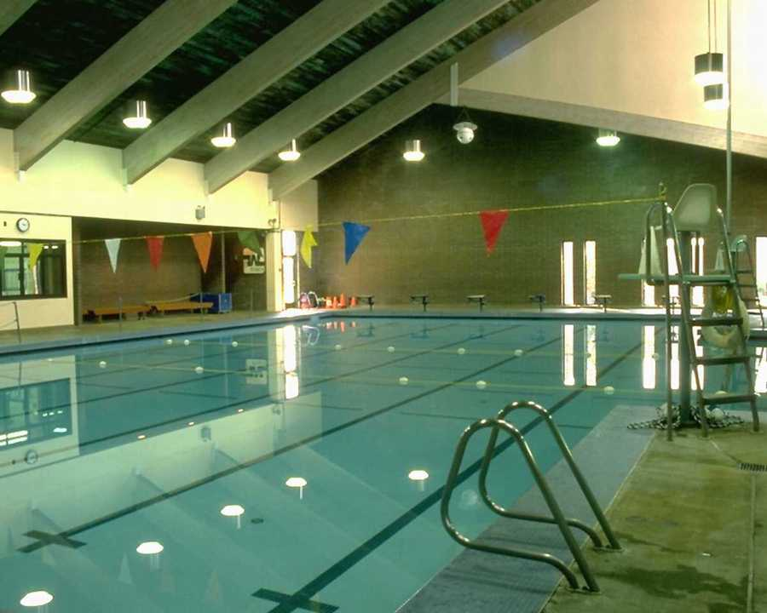
Parks, Pools and The Public
Reducing Your Liability
Notes:
Long ago, Municipalities recognized the need for Recreational and athletic facilities for the public. In earlier times, local governments provided little more than public parks.

Slide 2
Parks, Pools and The Public
Reducing Your Liability
Today, the municipal recreational role has expanded to include swimming pools, golf courses, walking trails, equestrian trails, ball fields, tennis courts, skateboard parks – almost any activity citizens participate in for enjoyment.
Notes:
During the summer months, with children out of school and warmer weather, the municipal role in recreation becomes even more important. If municipalities were not willing to open large amounts of land free of charge or at a small cost, many citizens would not be able to provide much in the way of entertainment or recreation.
Participating in recreational activities many or some times leads to injury. Accidents and Injury usually leads to blame. These days people are looking to blame someone else for their accident. So what can you do to protect yourself/
Try to provide the safest environment possible to eliminate or minimize injury. We will discuss the ways that you can go about doing this here shortly.
In the mean time lets discuss the protection that is afforded to you as a municipality in Alabama. We call it Recreational Use Immunity or Recreation land use statute.
The statute is found in the code of Alabama title 35 chapter 15

Slide 3
RECREATIONAL USE STATUTE
ARTICLE 1 (§§ 35-15-1 THROUGH 5)
Defines and limits the duties of an owner of
recreational land in relation to a person using
the land for recreational purposes.
  ARTICLE 2 (§§ 35-15-20 THROUGH 28) Defines and limits the duties of owners of noncommercial public recreational land
Notes:
THE “RECREATIONAL USE STATUTE” IS actually made up of two articles that were enacted at two different times.
1965 Articles 1
1981 (Article 2) applies to noncommercial public recreational landowners and provides them with even tighter limitations on exposure to liability than Article 1.
Section 35 15 27 of the code states that nothing in article 2 should be construed as altering or appealing the governmental immunity
Articles 1 and 2 are to be read TOGETHER

Slide 4
Legislative Intent
Article 1 was enacted to insure that landowners were not to be held to a standard of due care toward persons upon their land with permission for hunting, fishing and other recreational purposes.
Notes:
The intent of (Article 2) was to encourage the donation of non-commercial recreational property without exposing the owners of such property to lawsuits.

Slide 5
Article 1 (Section 35-15-1)
An owner…of premises owes no duty of care to keep such premises safe for entry and use by others for hunting, fishing, trapping, camping, water sports, hiking, boating, sightseeing, caving, climbing, rappelling or other recreational purposes.
Notes:
Further, Section 35-15-1 states that, with certain exceptions, there is no duty to warn of dangerous conditions
No duty to warn was upheld by Wright v. Alabama Power Co., 355 So. 2d 322 (AL 1978), the plaintiff was injured when he struck a fence partially submerged in a lake while he was riding an inner tube being pulled by a power boat. The lake had been created by a dam built by Alabama Power Company. The plaintiff alleged that Alabama Power owed him a duty to warn of the existence of the fence.
The court examined Sections 35-15-1 through 35-15-5 and held that persons upon land with permission or invitation for non business purposes are considered licensees. Therefore, the landowners owed no duty to warn of potentially dangerous conditions unless they do some positive act which creates a new hidden danger that a person could not avoid by the use of reasonable care and skill.
Licensees In Russell v. TVA, the federal district court stated, Licensees assume the risk of whatever they encounter on the property.

Slide 6
Article 2 (Section 35-15-22)
An owner who permits non-commercial public recreational use of outdoor recreational land owes no duty of care to inspect or keep such land safe for use by any person for any recreational purpose, or to give warning of a dangerous condition on such land to persons entering for such purposes.
Notes:
Keep in mind that 35-15-24.
Nothing in this article limits in any way legal liability which otherwise might exist when such owner has actual knowledge:
(2) That a condition, use, structure, or activity exists which involves an unreasonable risk of death or serious bodily harm;
(3) That the condition, use, structure, or activity is not apparent to the person or persons using the outdoor recreational land; and
(4) That having this knowledge, the owner chooses not to guard or warn, in disregard of the possible consequences.
15-24 goes on to say The statute excludes constructive knowledge by the owner as a basis of liability and does not create a duty to inspect the outdoor recreational land."
Constructive knowledge: is your presumed to have such knowledge, ex you were in the park today so you saw or should have seen the hole in the slide.
Actual knowledge is just what is sounds like, you actually know about the hole, there is a complaint, a work order, an inspection document showing you know of the damage.
Keenum v. City of Huntsville Upheld the no duty to inspect or give warning, but also clearly points out that there is a duty to warn if a defects exists and the owner has actual knowledge.
Ms Keenum lost her case and her appeal to the supreme court.
Ms. Keenum appeals from the summary judgment in favor of the City of Huntsville on her suit against it for damages based on alleged negligent and reckless maintenance of a spiral slide at Brahan Spring Park. Her foot was severely injured when she went down the slide and her shoe was caught in a hole in the side of the slide. She alleged in her complaint that a presumption exists that the City of Huntsville had actual knowledge of the condition of the slide.
several work order forms regarding repairs at Brahan Spring Park, none of those requests pertains to the slide. Affidavits from the park and rec employees
The Alabama Supreme Court said, Although Mrs. Keenum, in her complaint and in her brief, makes allegations of actual knowledge, she has provided no facts—i.e., no "substantial evidence"— suggesting that the City had actual knowledge. Thus, the summary judgment as to Mrs. Keenum's claim was proper

Slide 7
Exceptions to Recreational Immunity
The exceptions are listed in Section 35-15-3. First, a property owner or occupant is liable for willfully or maliciously failing to warn or guard against a dangerous condition, use, structure, or activity.
Second, if a property owner or occupant grants permission to use his or her property for hunting, fishing, trapping, camping, hiking, or sightseeing for a commercial benefit, the owner is responsible for any injuries which result.
Notes:
Finally, the property owner or occupant is liable to third persons to whom he or she owes a duty if someone using the property – with the owner’s permission – to hunt, fish, trap, camp, hike or sightsee, damages the third person’s property.

Slide 8
35-15-28. Owner Must Establish Public Use
The liability limitation protection of this article may be asserted only by an owner who can reasonably establish that the outdoor recreational land was open for non-commercial use to the general public at the time of the injury to a person using such land for any public recreational purpose.
Notes:
For the statute to apply the outdoor recreational land must be open for non-commercial use to the general public at the time of the injury.
An owner can create a presumption of having opened land for non-commercial public recreational use by:
(1) Posting signs around the boundaries and at the entrance(s) of such land; or
(2) Publishing a notice in a newspaper of general circulation in the locality in which the outdoor recreational land is situated, and describing such land; or
(3) Recording a notice in the public records of any county in which any part of the outdoor recreational land is situated, and describing such land; or
(4) Any act similar to subdivisions (1), (2), or (3) of subsection (a), which is designed to put the public on notice that such outdoor recreational land is open to non-commercial public recreational use.

Slide 9
Recreational Immunity Example
In Glover v City of Mobile, (1982), the city of Mobile operated a city park that bordered on the shoreline of the Dog River. The park was open to the public. No admission fee was charged. Two children drowned while swimming in the Dog River, although the city did not permit swimming at the park. The court found that since the children were on the property without financially benefiting the city, they were licensees, and the city was not liable for their deaths.
Notes:
Grice v. City of Dothan, 670 F. Supp. 318 (M.D. AL 1987), a child drowned while swimming at a public park owned by the city of Dothan. The property was used for fishing and picnicking and was clearly marked with “No Swimming” signs.
The court pointed out that, in Alabama, the purpose for which property is maintained is the controlling factor. The court said that Chapter 15 of Title 35 limits the city’s liability only to acts which constitute willful or malicious failure to guard or warn against a dangerous condition or activity on the property. The court found no facts to support such a claim.
Very important The plaintiff also alleged the court should consider the age of the victim as a mitigating circumstance. The court pointed out that Section 35-15-21(4) specifically defines a person to be any individual, regardless of age. Therefore, the exceptions to the general rules of premises liability which protect children do not apply in cases governed by these sections

Slide 10
Recreation Immunity Example
Edwards v. City of Birmingham,
(AL 1984), the plaintiff was injured while playing baseball at a city-owned park. Because he did not pay an admission fee, the court found he was a licensee, and the city was not liable.
Notes:
So does this mean that you can’t charge admission fees and still receive protection from the statute….. Of course not
The fact that a municipality or board charges an admission fee does not automatically remove the protection of the statute.
Whether the fees you charge will effect your protection or not depends whether or not the land is being used for non commercial recreational use.
Article 2 defines commercial use: Any use of land for the purpose of receiving consideration for opening such land to recreational use where such use or activity is profit-motivated. (35-15-21(5)).
In Owens v grant the supreme court pointed out that the fact that fees were charged does not mean that the use of the land was profit motivated.
Your admission fees help recoup some of your operating costs or you use the fees to improve the park or facilities, that’s not the same as profit motivated. Your $3.00 fee to your million dollar slide and swimming pool will never make a profit.
Another example is occurred in the City of Gadsden

Slide 11
Admission Fees
In Martin v. City of Gadsden,(AL 1991), the Alabama Supreme Court held that these liability limitations shield municipalities from liability even where an admission is charged, provided that the facility is not operated for profit. Thus, the key issue is whether the fee charged is sufficient for the municipality or board to make a profit. These sections merely require that the recreational facility operate on a noncommercial basis.
Notes:
On July 10, 1988, the Martins were celebrating Tyson's second birthday at Noccalula Falls Park, which is owned and operated by the City. The Martins had reserved a pavilion at the park, and Tyson began playing barefoot in the grass with other children. That afternoon, Tyson stepped on a pile of hot charcoal briquets that had been dumped onto the ground earlier in the day. As a result of this incident, Tyson's feet were seriously burned and he was hospitalized for treatment.
The complaint against the City alleged that the defendant had negligently or wantonly allowed a dangerous condition to exist at the park and the dangerous condition was the cause of Tyson's injuries. In their answer, the City contended that the park had been set aside for recreational use by the public, and that the use was noncommercial. As a result, they asserted that the City was shielded from liability for Tyson's injuries.
Just like the Keenum case, the City did not have actual knowledge of the dangerous condition or hot coals in this case.
At trial, and on appeal, Tyson has argued that Recreation Immunity does not apply because, he says, The Park is a commercial enterprise. He argues that because the City charges admission fees to some users of the park and because there are 13 income generating attractions or concessions at the park, it is a commercial enterprise and therefore falls outside the protection extended by the statute.
In Owens case I mentioned a second ago, the Supreme Court was asked to interpret the phrase "profit-motivated.” remember we said the fact that entry fees were charged by the landowner did not necessarily mean that the use of the land was "profit-motivated.“
Instead of adopting a rigid definition of the phrase profit motivated, The supreme Court decided that the question of whether a landowner intends to derive a profit must be decided on a case-by-case basis.
So that’s what happened in Martin V Gadsden After reviewing the testimony offered by the City, this Court concludes that there was sufficient evidence to support the jury's finding that the City did not intend to derive a profit from the park. Although fees were charged for certain activities within the park(remember admission fees and 13 income generating attractions or concessions), it is clear that those fees only partially defrayed the cost of operating the park and that the park has never produced a profit. As a result, this Court will not disturb the jury's finding that the City's operation of the park was not "profit-motivated." The supreme court upheld this decision.
Last example case and we will move on.

Slide 12
Last Example Case
Ex parte City of Geneva, (AL 1997), In City of Geneva, the city placed a one-foot high fence around the entrance of the park to allow pedestrians to enter while keeping vehicles out of the park. There was also at the entrance a walk area a few feet wide between the post and another fence that allowed pedestrians to go around the cable.
Notes:
So it is obvious from these three or four cases that the statute will protect you but it will not prevent the lawsuit. It not going to prevent you from filing a claim which in turn could affect your premiums. The statute may not always guarantee you immunity from liability.

Slide 13
Last Example Case
An 11-year-old girl broke her leg when she failed to step over the cable after dark. When the cable was first installed, the city attached a caution sign and white cloth strips to it, but there was some evidence suggesting that warning devices might not have been affixed to the cable when the accident in this case occurred. The trial court awarded the plaintiff $20,000 and the Court of Civil Appeals upheld the verdict.
Notes:
On June 14, 1991, Christina entered the park in the late afternoon, accompanied by five girlfriends, also minors, and an adult chaperon, Mrs. Dixie Lee. This was Christina's first trip to C.D. Chapman Memorial Park. She testified that when she entered the park there was still some daylight and that she saw and easily stepped over the cable at the entrance. After watching some baseball games, the group decided to leave, sometime around 8:30 to 9:00 p.m. When the girls neared the park entrance, they began to run toward the chaperon's car, which was parked in the lot outside the cable. As the group of running girls approached the cable, the chaperon attempted to remind the girls of the cable, by saying either, "Watch out" or "Watch out for the wire." Several girls successfully jumped the cable, but Christina and one of her friends hit the cable and fell. Christina suffered a broken leg as the result of her fall. Christina testified that she did hear the chaperon's warning while she was running, but heard it only when she was right at the cable. She admitted that upon hearing the warning she did see the cable and tried to jump it, but she said that because of the darkness she had not seen the cable in time to stop or jump all the way over it.
jury to find that the cable was "not apparent to the person or persons
But the Supreme Court further strengthened the statute when they reversed the decision.

Slide 14
Strength of Recreational Immunity
The Alabama Supreme Court reversed the decision. The court held that the plaintiff failed to present substantial evidence that the danger presented by the cable was not apparent, and in order to hold the municipality liable for an injury to a licensee, the danger had to be unavoidable by a person using reasonable skill and care, known to the municipality, which then failed to warn about the danger.
Notes:
“… the undisputed evidence shows that the cable could be seen by the use of reasonable care, and, therefore, the City had no duty to warn licensees using the park of its presence. Several of the other minors at the park with [the plaintiff] were able to see and jump over the cable only moments before her accident, even as they too were running out of the park. [the plaintiff] admitted that she knew of the cable because she had stepped over it upon entering the park. Finally, there was no evidence that anyone besides [the plaintiff] had ever tripped over the cable, despite the park’s history of nighttime use.”

Slide 15
Good News vs Bad News
The Good News is that the Recreational Use Statute is strong.
The Bad…
Loss Control doesn’t want you to rely on the statute.
Notes:
Recreational Use Statute is what AMIC’s attorneys fall back on when you get sued,
Loss control’s job or goal To keep you from getting sued….
So could the city do better job to prevent the accident. Sure they could for one they could install lighting .
We rely on safe playground equipment, soft fill material, fencing, lifeguards, proper maintenance, quality employees, sound recreation risk management practices.

Slide 16
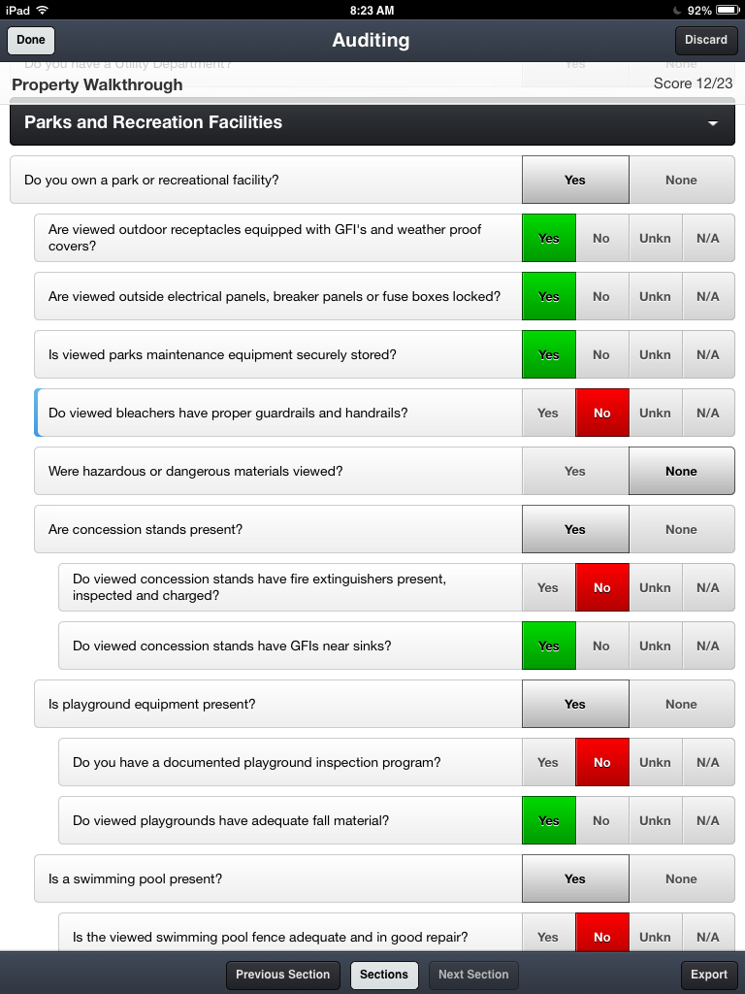
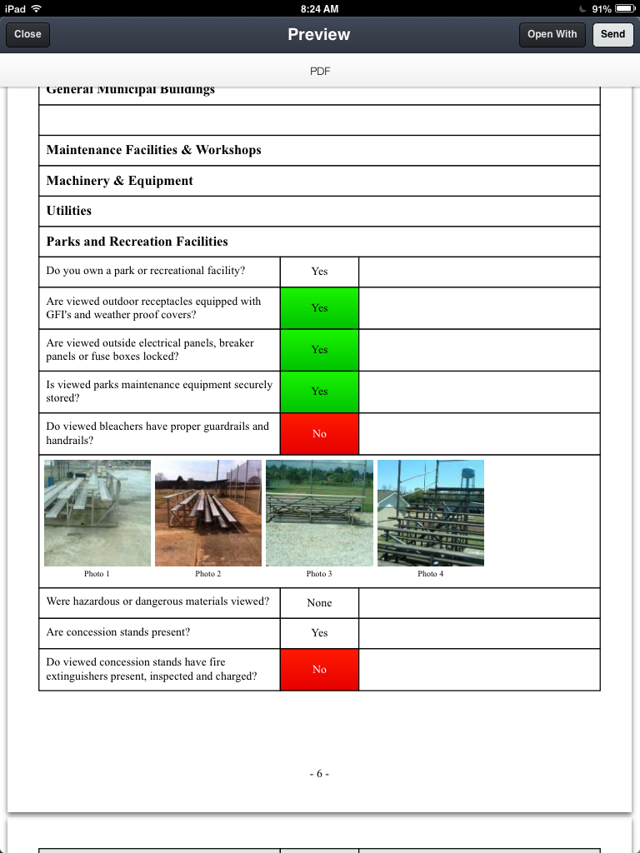
What Does Loss Control Look for?

Slide 17
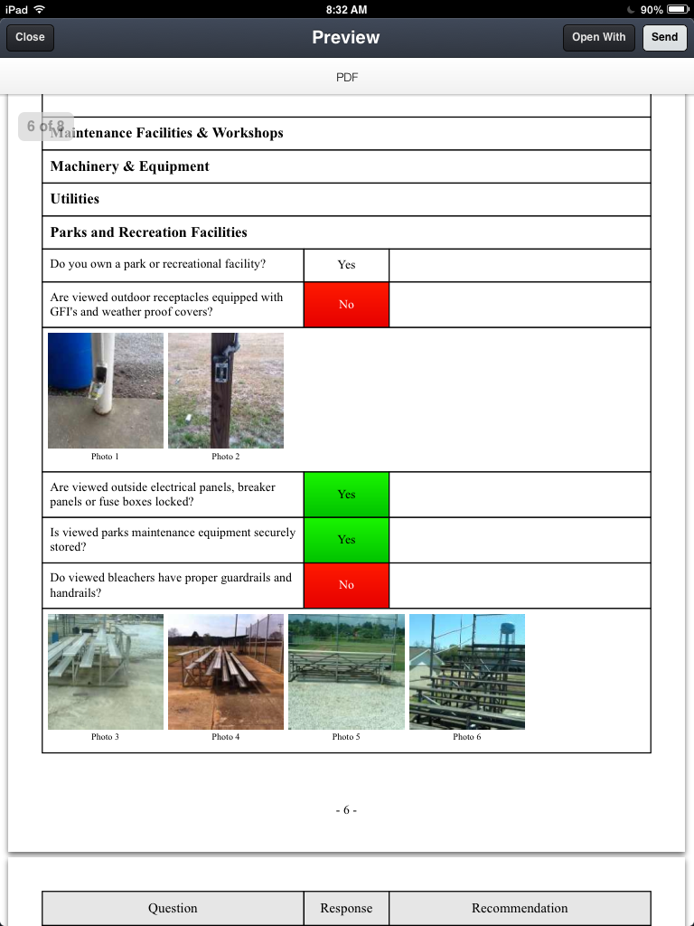
What Does Loss Control Look for?

Slide 18
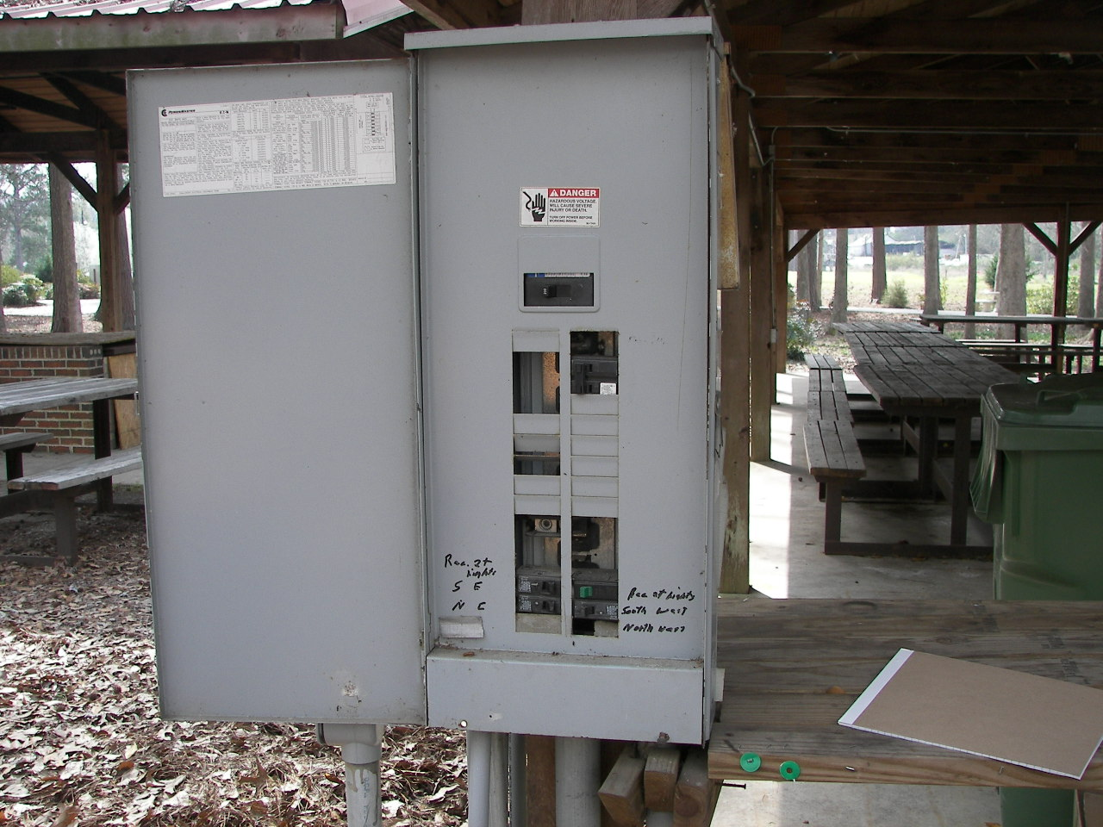
Electrical Panels

Slide 19
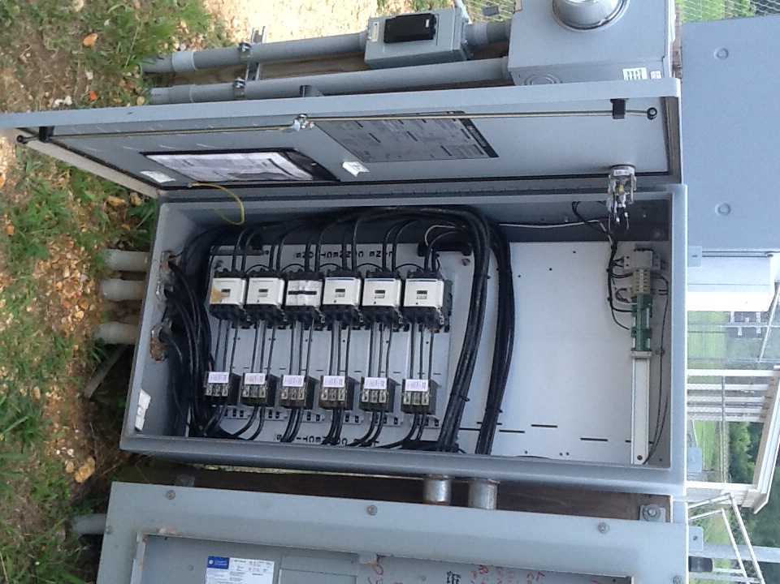
Electrical Panels

Slide 20
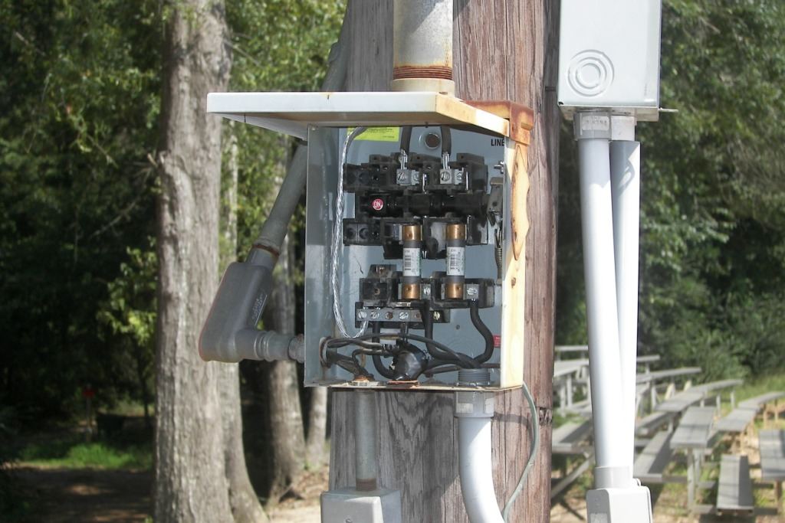
Electrical
Notes:
So as a best practice all outdoor panels should be locked, have dead front covers, blanks spaces covered.

Slide 21
Bleacher Safety

Slide 22
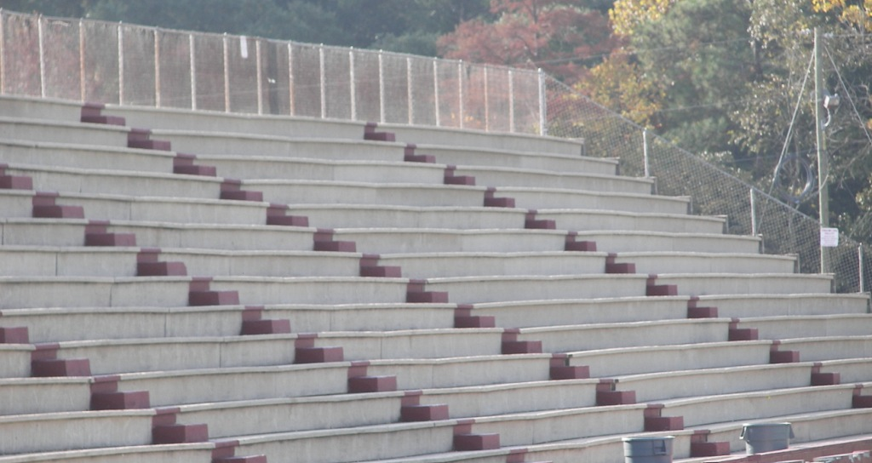
Bleacher Safety

Slide 23
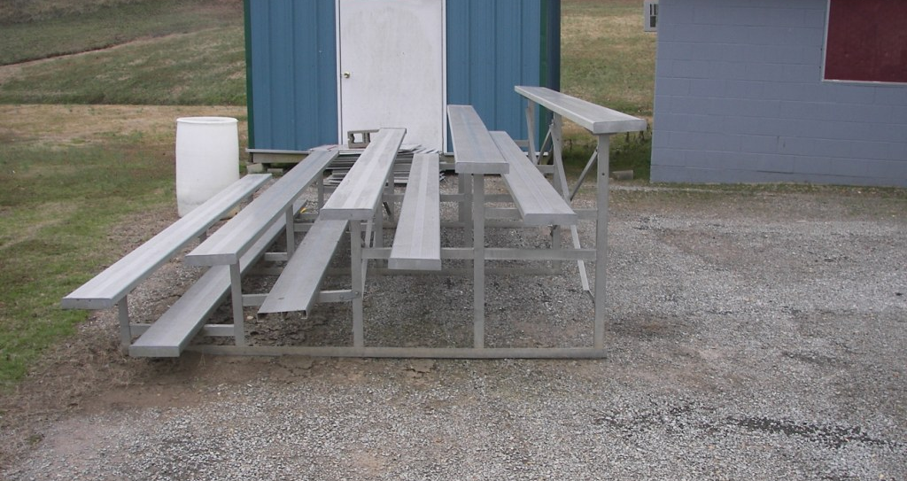
Standard Bleachers

Slide 24
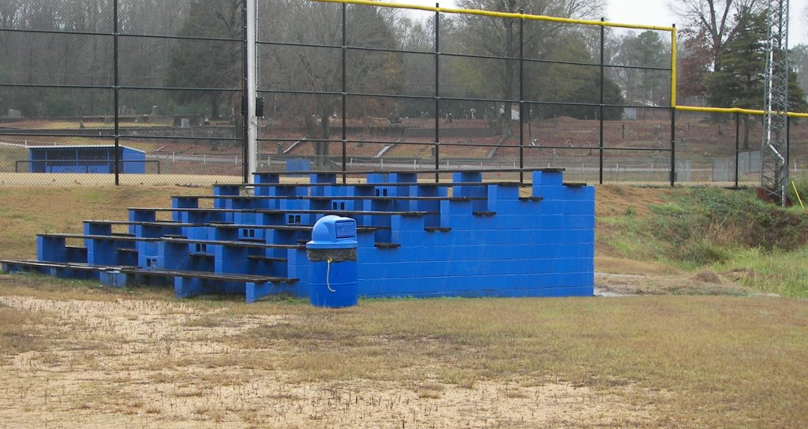
Bleacher Accident

Slide 25
Bleacher Safety
Guardrails should be present on the backs and portions of the open ends of bleachers where the footboard, seat board, or aisle is 30 inches or more above the floor or ground.
The top surface of the guardrail should be at least 42 inches.
Any opening between components of the guardrail or under the guardrail should prevent passage of a 4-inch sphere.

Slide 26
Bleacher Safety
Bleachers should be thoroughly inspected at least and problems corrected immediately.
All inspections documented and records should be retained.
Bleachers with the top row nominally 30 inches above the ground may be exempt.

Slide 27
Concession Stands
Notes:
Inspect Concession stands regularly, remove fire hazards, look at electrical, make sure all wiring is done professionally and is up to the NEC. We find indoor wiring outdoors.
Compressed Gas cylinders are secured, exits commonly get blocked due to the limited amount of space. Slip and fall areas around the concession stands due to the window unit dripping on the concrete forming a slick surface. Good lighting

Slide 28
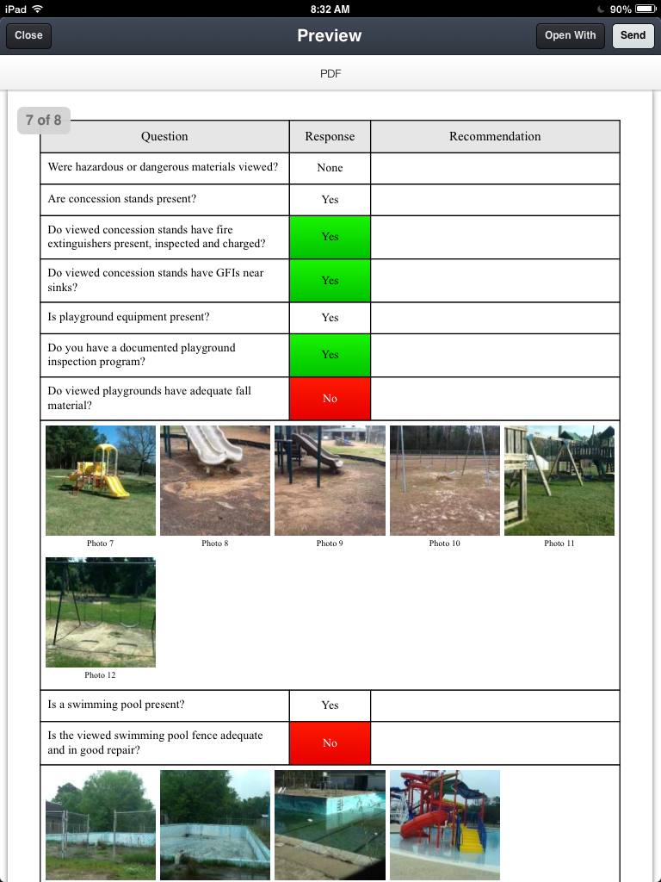
Playground Inspection

Slide 29
Playground Inspection and Maintenance
The safety of playground equipment depends on good inspection and maintenance.
Inspection and maintenance schedule should be developed based on actual playground use.
Notes:
Frequently used playgrounds will require more frequent inspections and maintenance
Maintenance inspections should be carried out in a systematic manner by personnel
familiar with the playground, such as maintenance workers,
Park and rec supervisors, etc
Some manufacturers
supply checklists for general or detailed inspections with
their maintenance instructions.
Playground safety handbook sample form included

Slide 30
Playground Inspection
All playground areas and equipment should be inspected for excessive wear, deterioration, and any potential hazards, such as
Broken equipment, loose bolts, missing end caps, cracks, etc.
Broken glass & other hazards.
Notes:
Next slide
Some common hazards we see:

Slide 31
Common Playground Hazards
Cracks in plastics
Loose anchoring
Hazardous or dangerous debris
User modifications (such as ropes tied to parts or equipment rearranged)
Vandalism
Worn, loose, damaged, or missing parts
Wood splitting
Rusted or corroded metals
Rot

Slide 32
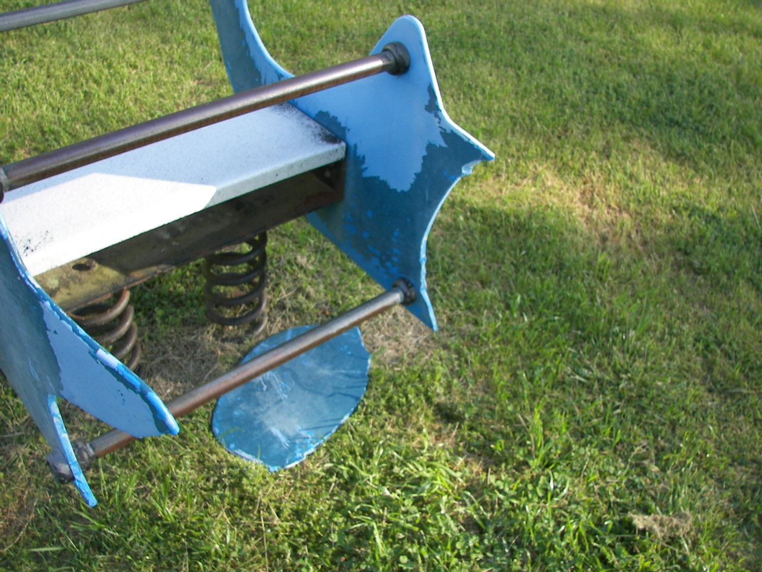
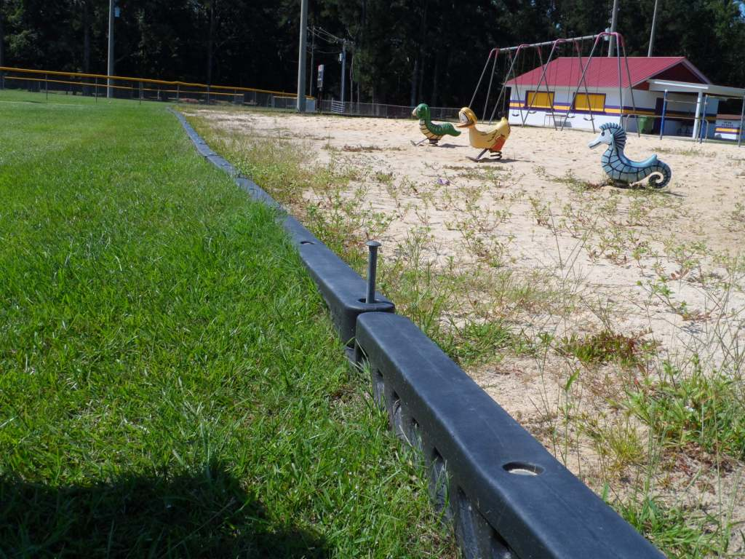
Playground Inspection
Notes:
Next slide we need to make sure that were not just looking for these obvious problems, we need to pay special attention to moving parts and other
parts that can wear.

Slide 33
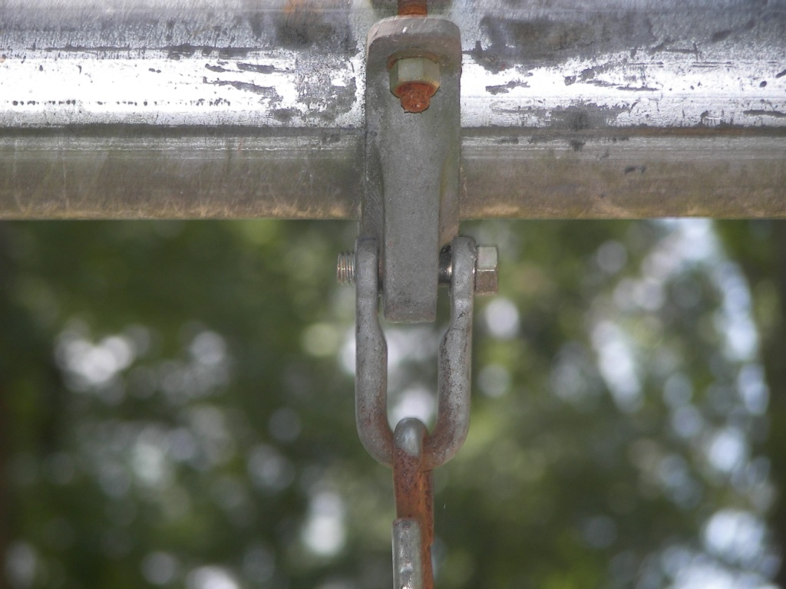
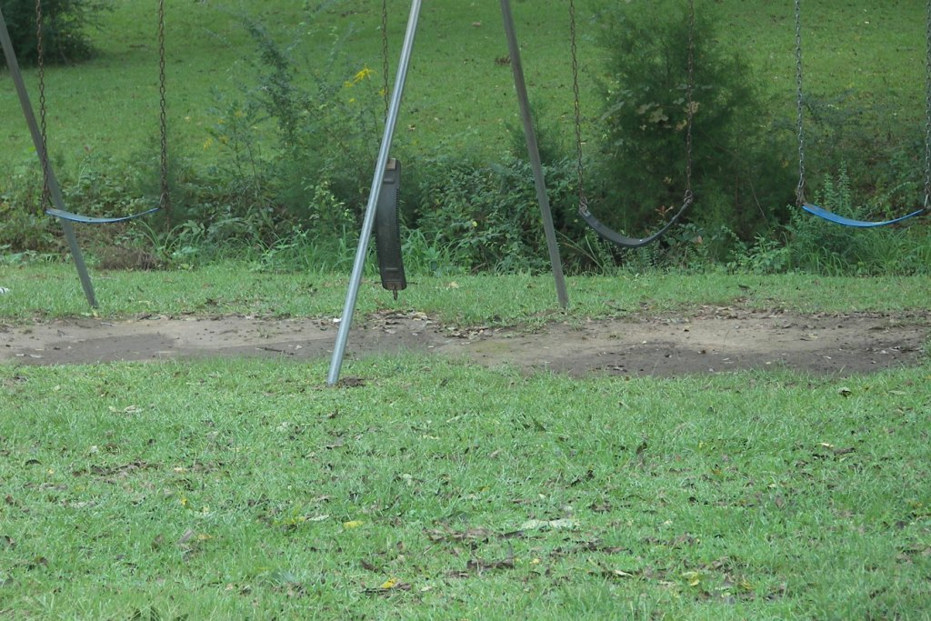
Playground Inspection
Notes:
Missing nut
Gordo swing set

Slide 34
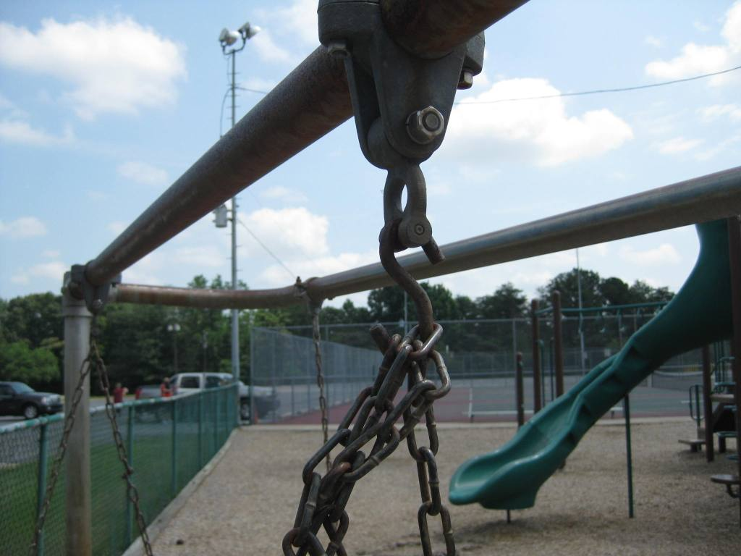
Notes:
All hooks, such as S-hooks and C-hooks, should be closed (see also §5.3.8.1). A hook is considered closed if there is
no gap or space greater than 0.04 inches, about the thickness of a dime. Open hooks can be an entanglement hazards

Slide 35
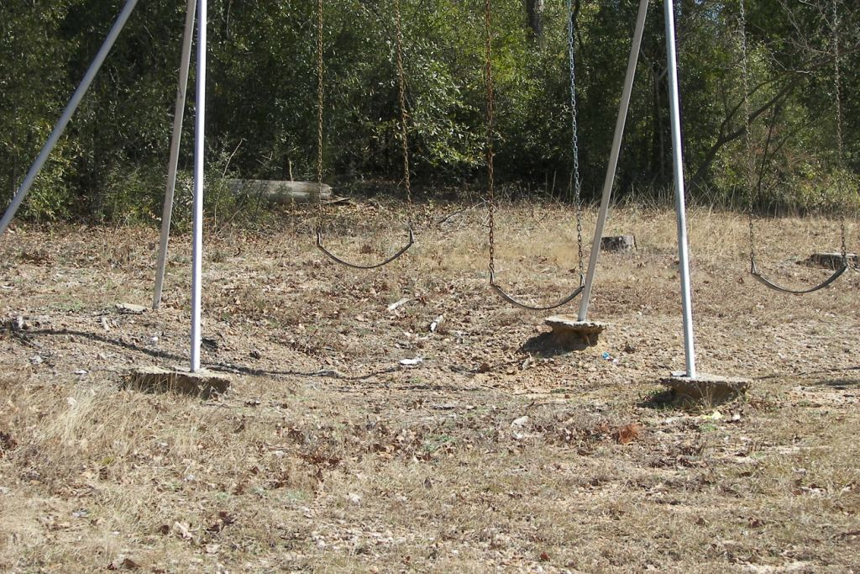
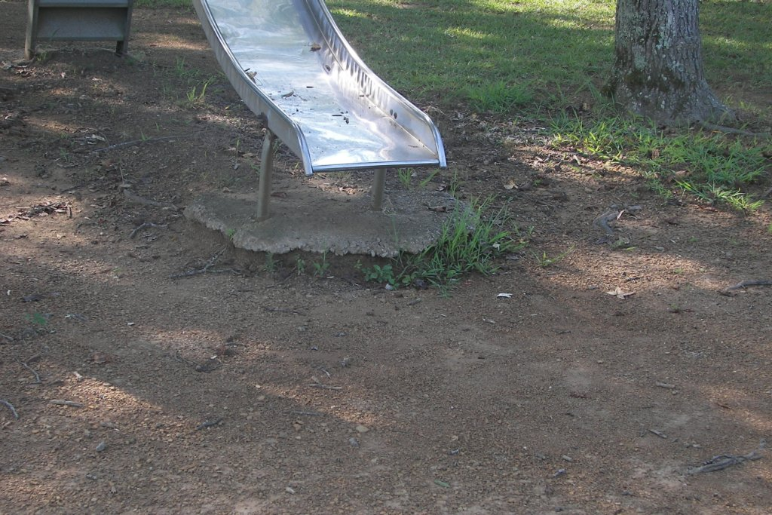
Playground Inspection
Notes:
The soil has eroded leaving concrete exposed, 1 not anchored as good now, 2 a child can easily become injured.
The statute is for your protection but you as a city or town can protect you citizens by inspecting and maintaining your parks.
Next slide soft fill

Slide 36
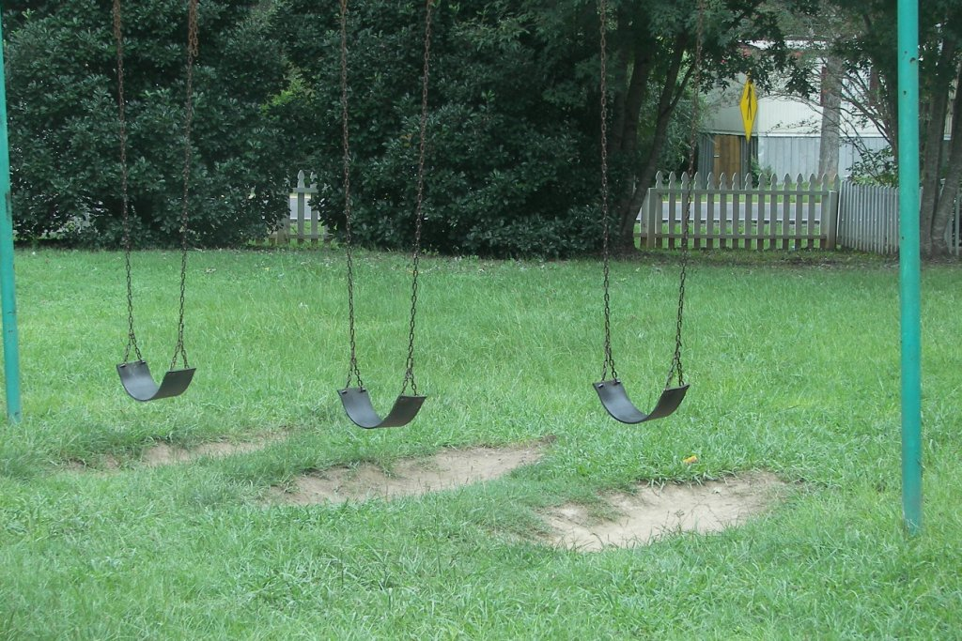
Soft-fill or Fall Material
The surfacing under and
around playground equipment
is one of the most
important factors in reducing
the likelihood of life-threatening
head injuries.
Notes:
Grass and dirt are not considered protective surfacing because wear and environmental factors can reduce their shock absorbing
Effectiveness.
Loose-fill surfacing materials require special maintenance.
High-use public playgrounds should be checked frequently to ensure surfacing has not displaced significantly, particularly in areas of the
playground most subject to displacement (e.g., under swings and slide exits).
This can be facilitated by marking ideal surfacing depths on equipment posts.
Displaced loose-fill surfacing should be raked back into proper place so that a constant depth is maintained throughout the playground.
Also notice the three swings together, shouldn’t be but two swings per bay or between posts. For park design please refer to the playground safety handbook. Like all resources you can find them under the services and resources tab. Click on the reference documents and perform a search.

Slide 37
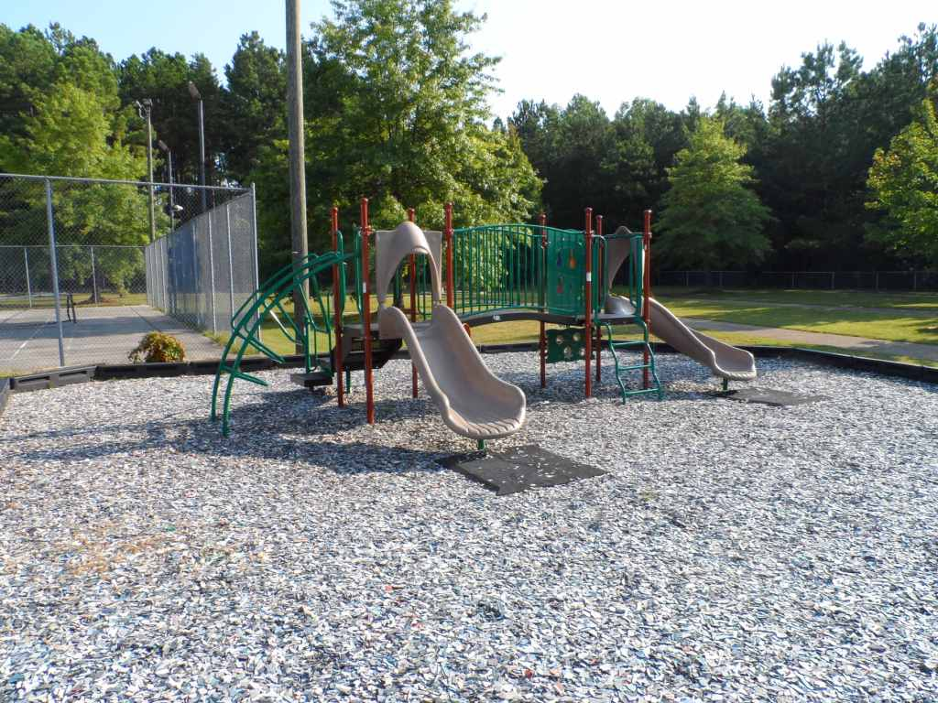
Appropriate Surfacing
Any material tested to ASTM F1292, including
unitary surfaces, engineered wood fiber, etc.
• Pea gravel
• Sand
• Shredded/recycled rubber mulch
• Wood mulch (not CCA-treated)
• Wood chips
Notes:
ASTM This test simulates the impact of a child’s head hitting the surface from various heights of the playground equipment.
Never use less than 9 inches of loose-fill material. Shallower depths are too easily displaced and compacted.
In case questions are asked
CCA Chromate Copper Arsenate Wood Preservative, Since December 31, 2003, CCA-treated wood is no longer
processed for use in playground applications.
ASTM
Standard Specification for Impact Attenuation of Surface Systems Under and Around Playground Equipment”, which is known by its numerical designation, F1292. This standard accounts for both the deceleration of the head during impact and the length of time the head takes to stop moving.

Slide 38
Additional Parks and Recreation
Tennis Courts
Equestrian Trails and Arenas
Walking trails
Ponds
Golf Courses
Ball Fields
Gymnasiums
Notes:
Documented Routine Inspections
Post rules and proper signage
Monitor usage
Secure after hours
Ball field rental agreements
Trip and fall hazards
Hazardous materials chemicals pesticides herbicides all secured
Baseball field fencing safety cap - Protects players from injury and acts as a visual warning for outfielders approaching the fence.
Dugouts are covered
Other hazards we sometimes see while visiting

Slide 39
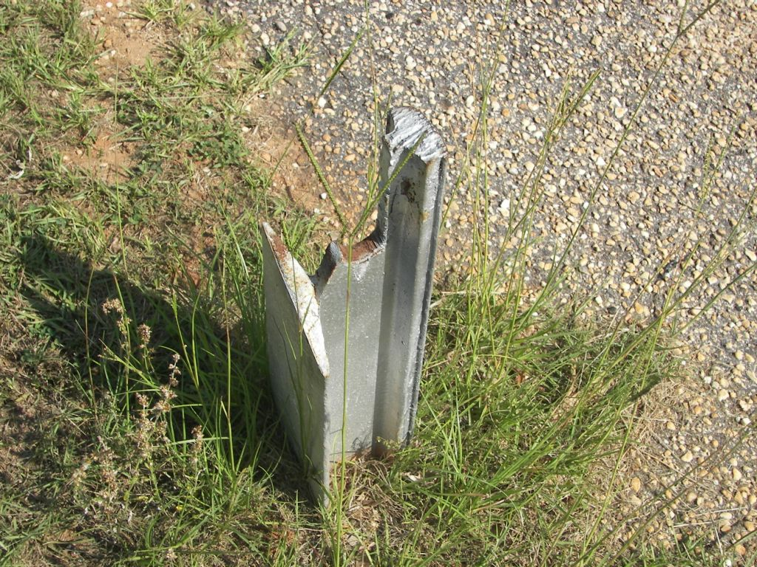

Slide 40
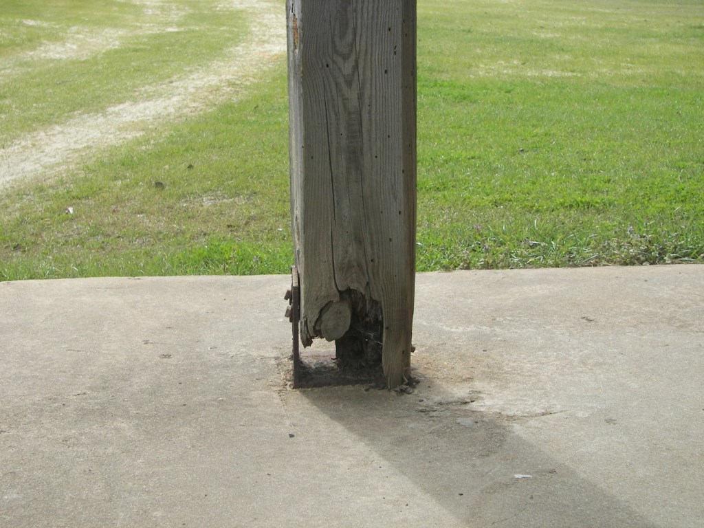

Slide 41
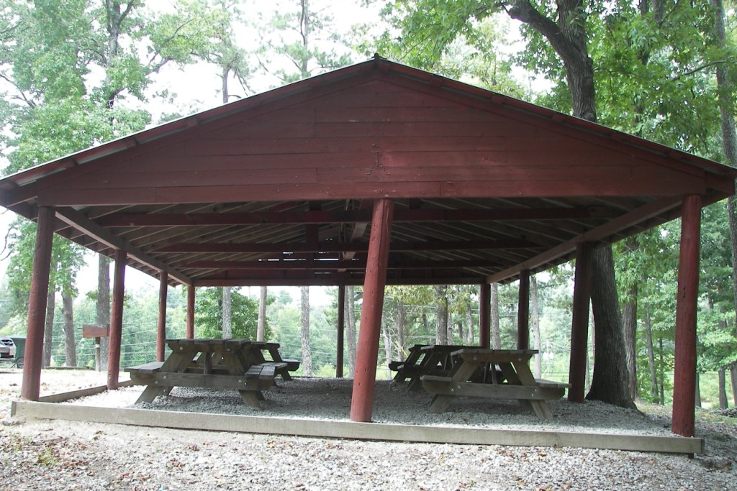

Slide 42
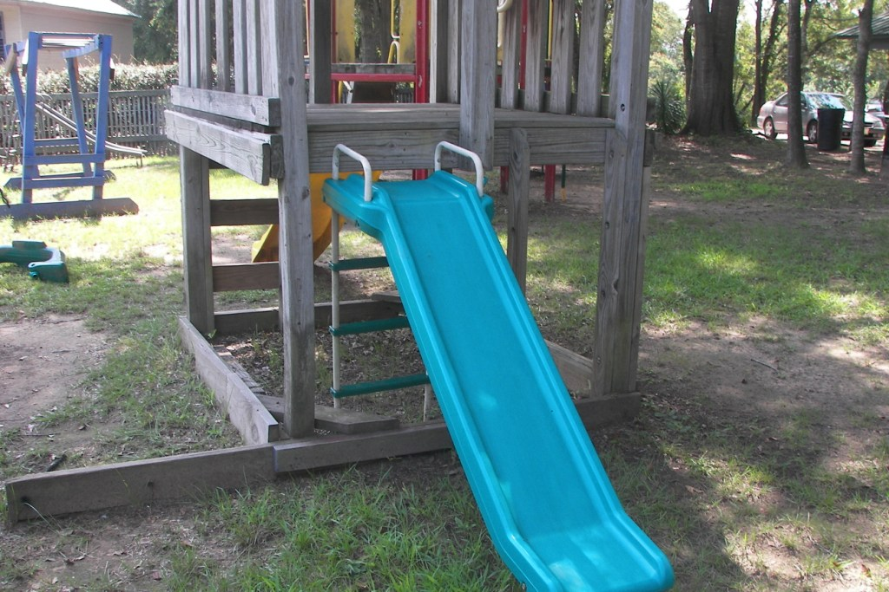
Notes:
Make shift or residential equipment shouldn’t be open for public use.

Slide 43
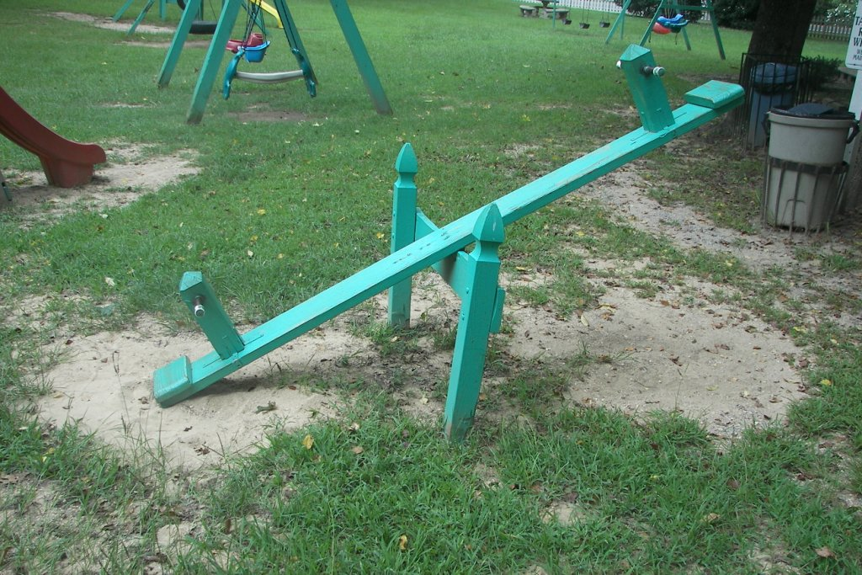
Notes:
Careful when making equipment. I understand your trying to save money but we need to make sure it is safe.
Seesaws are ok just not ones like this.
• Shear points should be covered
• The maximum attainable angle between a line connecting
the seats and the horizontal is 25°.

Slide 44
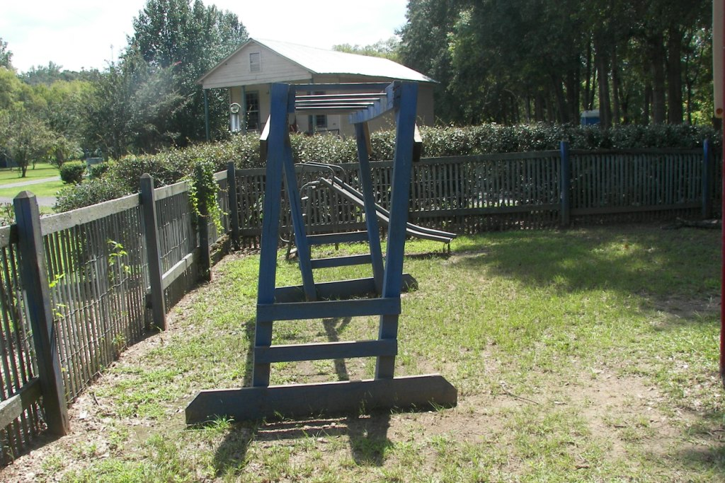
Notes:
Again homemade equipment just doesn’t hold up to high volume public use.

Slide 45
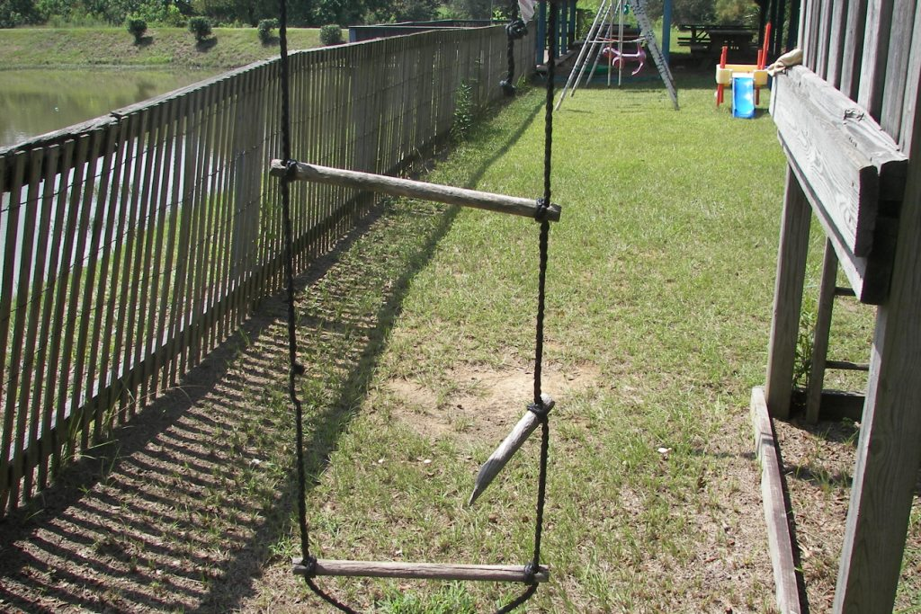

Slide 46
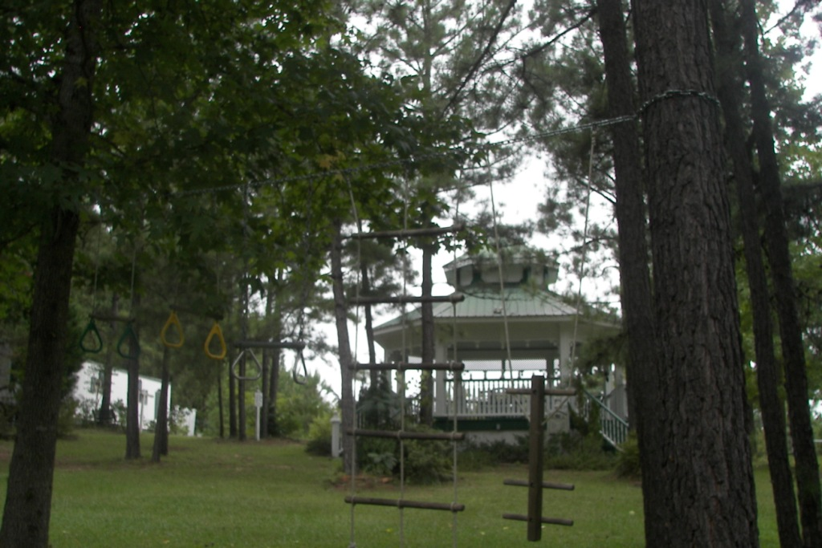
Notes:
An actual certified playground inspector may have a heart attack seeing this.

Slide 47
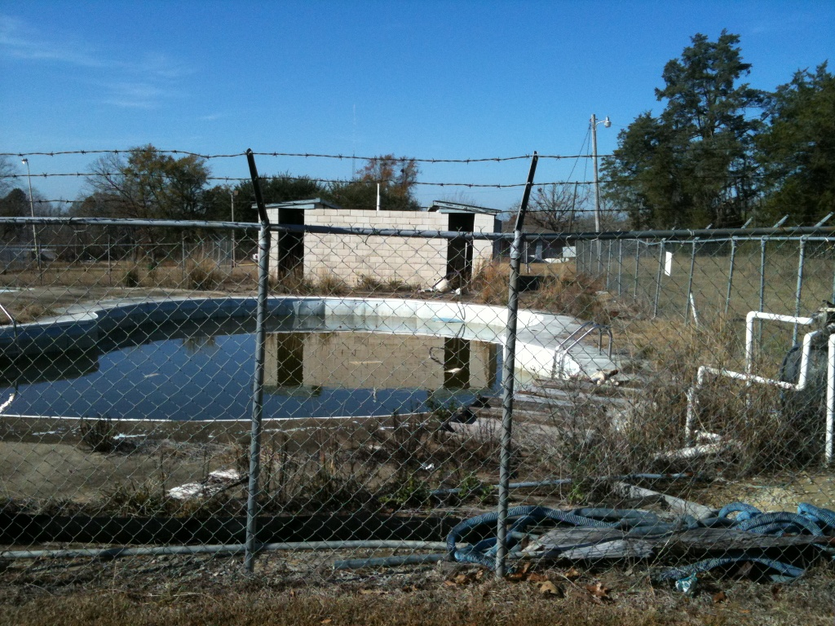
Swimming Pools
Public swimming pools offer fun and relaxation during the summer.
However, even with proper loss control measures, swimming pools can present significant exposures for public entities.
Notes:
Aquatics facility managers and staff have a very important job of maintaining a safe facility for both the employees as well as the public.
Good policies and proper procedures help minimize and sometimes even eliminate liability exposures.

Slide 48
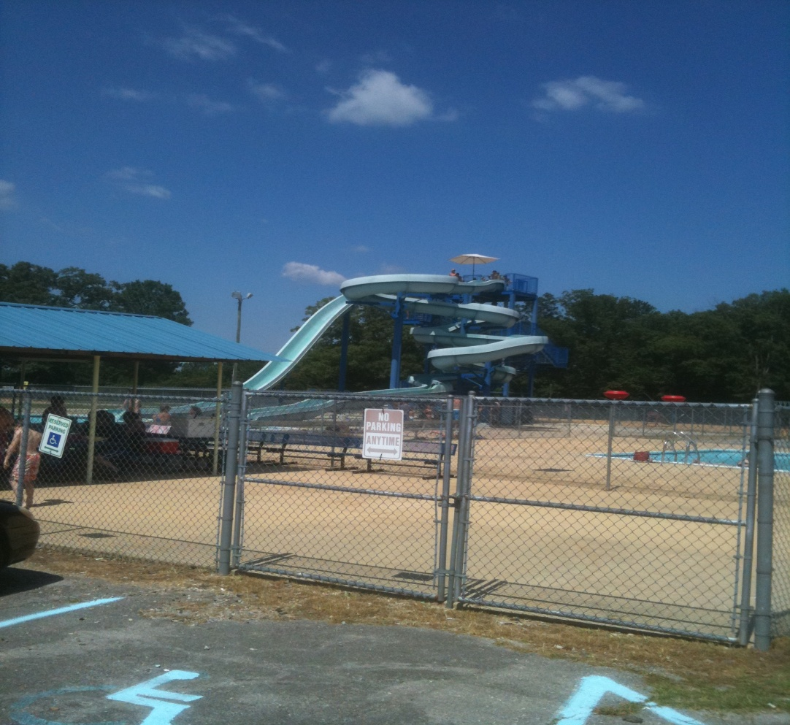
Security
Discouraging and preventing unauthorized entry is an important part of an aquatics facility ‘s risk management program.
Notes:
For the protection of the facility and the public, access to public swimming pools should be controlled.

Slide 49
Security
Sound security measures may help reduce the risk of injury, death, and liability at municipal aquatics facilities.
Gates and doors remain locked or directly supervised
Areas around the facility should be cleared of chairs, overhanging tree limbs, or other items that could be used for gaining access to the enclosed pool area.
Security measures to consider are lighting, cameras, and security alarms.
Notes:
On the outside of the fence, signs indicating “No Unauthorized Access or do not enter” will serve to warn potential unauthorized entrants.
Regularly check the fence for signs of damage. Inspect fencing, gates, latches, and locks daily.
Check the pool at the close and opening of every day. Facility managers have found people who died in their pools after the facility closed.

Slide 50
Water Quality
Do you document pool water testing?
Maintaining proper
water quality is
important for safety and sanitation.
Because of the risk of recreational water illness(RWI) proper sanitary procedures should be adopted.
Notes:
Document water testing What is to be recorded- Water clarity, Operating periods of pumps & filter, Flow rate, Chemicals added, Disinfectant residuals, pH, water quality, alkalinity (monthly)
Regarding water clarity, Cloudy water indicates a water quality problem. If you cant see the bottom obviously you need to close the pool. It is necessary to see the bottom so that all swimmers can be seen as well as to ensure that the water is safe.
Because of the risk of recreational water illness we need to educate users about showering before after entering the pool, not spitting or putting pool water in their mouths, not entering the pool if recently ill, especially with diarrhea and vomiting. Require swim diapers on children who are not potty trained.
CDC handout

Slide 51
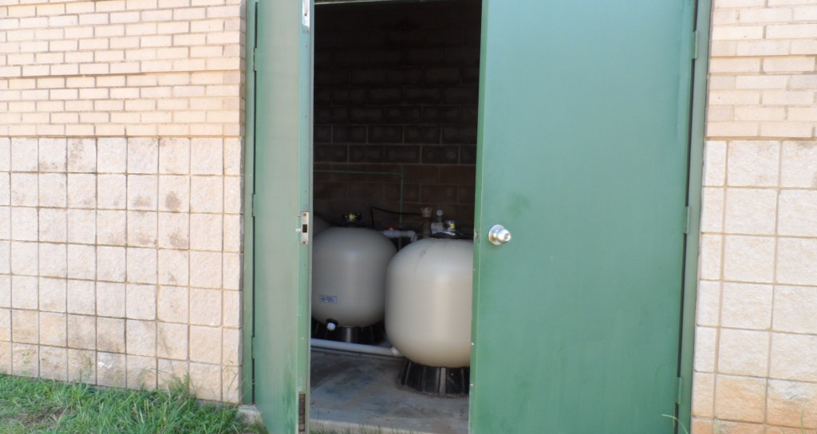
Are Pool Chemical and Pump Rooms Locked?
Notes:
Chemical and pump rooms should be secured at all times to prevent public access and should be labeled with appropriate warning signs.
Reduces opportunity for theft, vandalism, injury, as well as decreases liability exposure.

Slide 52
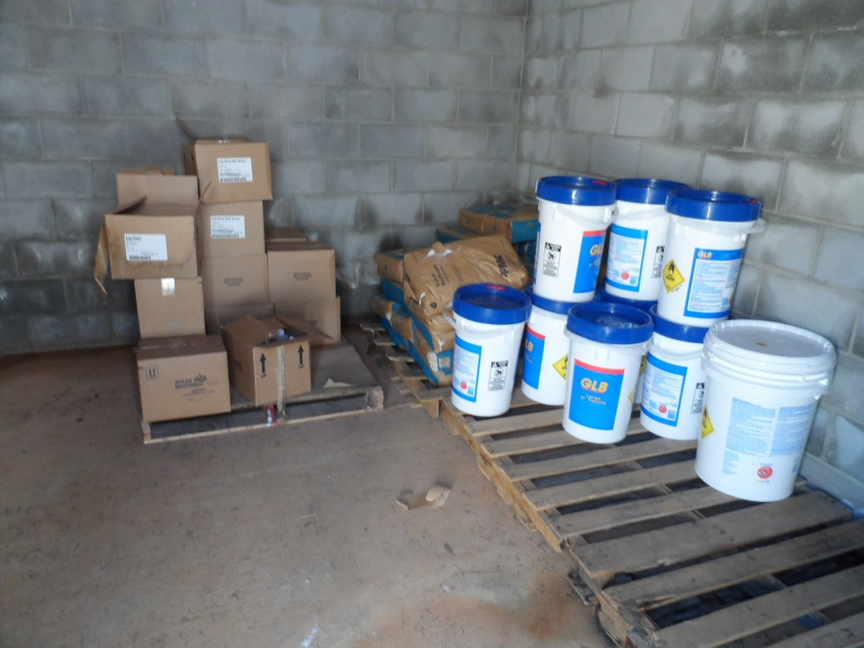
Chemical Storage
Notes:
It is best to store pool chemicals in an area dedicated solely to them. Many pool/spa chemicals are corrosive to metals and should not be stored in the same room with metal equipment (such as a pump or utility room). Keep pool/spa chemicals away from other chemicals and equipment such as lawn mowers, fuel and lubricants, organic pesticides, solvents, paints and thinners. Mixing of chemicals may start a chemical reaction resulting in fire, release of toxic gasses, or explosion.
Proper storage helps prevent accidental mixing of chemicals.

Slide 53
Storing and Handling Chemicals Safely
Store chemicals properly in a cool, dry well-ventilated area.
Stored chemicals should be elevated off the floor.
Follow label directions carefully.
Avoid mixing or contaminating chemicals.
Notes:
Under normal circumstances, pool chemicals are intended to be added to large quantities of water. If, instead, a limited volume (amount) of water is added to a chemical, an unwanted reaction may occur, resulting in an increase in temperature and the release of toxic gas.
Are acids and chlorine stored separately? Never store oxidizers and acid near each other. Oxidizers will release chlorine gas if they come in contact with acids.
Hazardous substances are capable of being safely handled day-after-day through a management system that ensures that good, written procedures are prepared, posted, and followed by trained employees.
Next Safety Rules

Slide 54
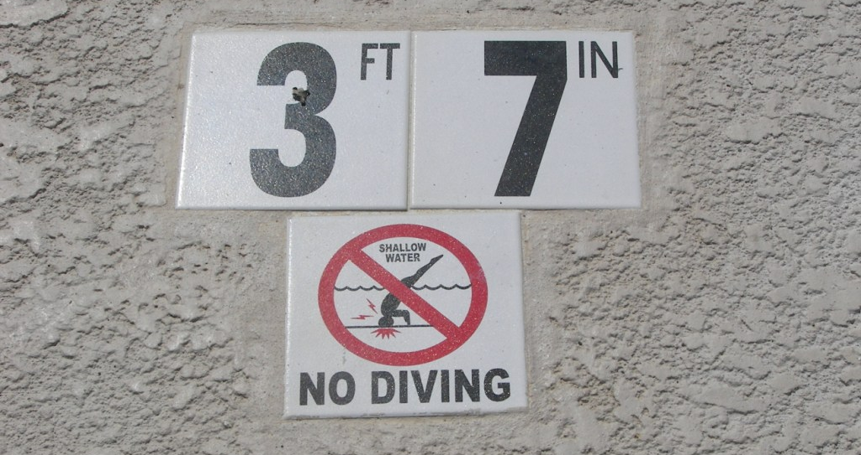
Safety Rules
Notes:
Pool rules are very important for the safety of the public and your staff as well as the protection of your facility. Signage is one way to communicate safety rules. Concise pool rules should be posted in the most visible location at the entry way as well as other locations as the situation requires.
An example would be signage on the deck such as depth markers, no diving, or please walk or no running signs posted around the pool.
Rules should address situations such proper age to be left without a parent, proper attire such as no cut-off shorts or frayed clothing , no running or no diving is permitted anywhere at this facility, Rough play not allowed, and things like children in regular diapers are not permitted in the pool. Swim diapers are allowed.

Slide 55
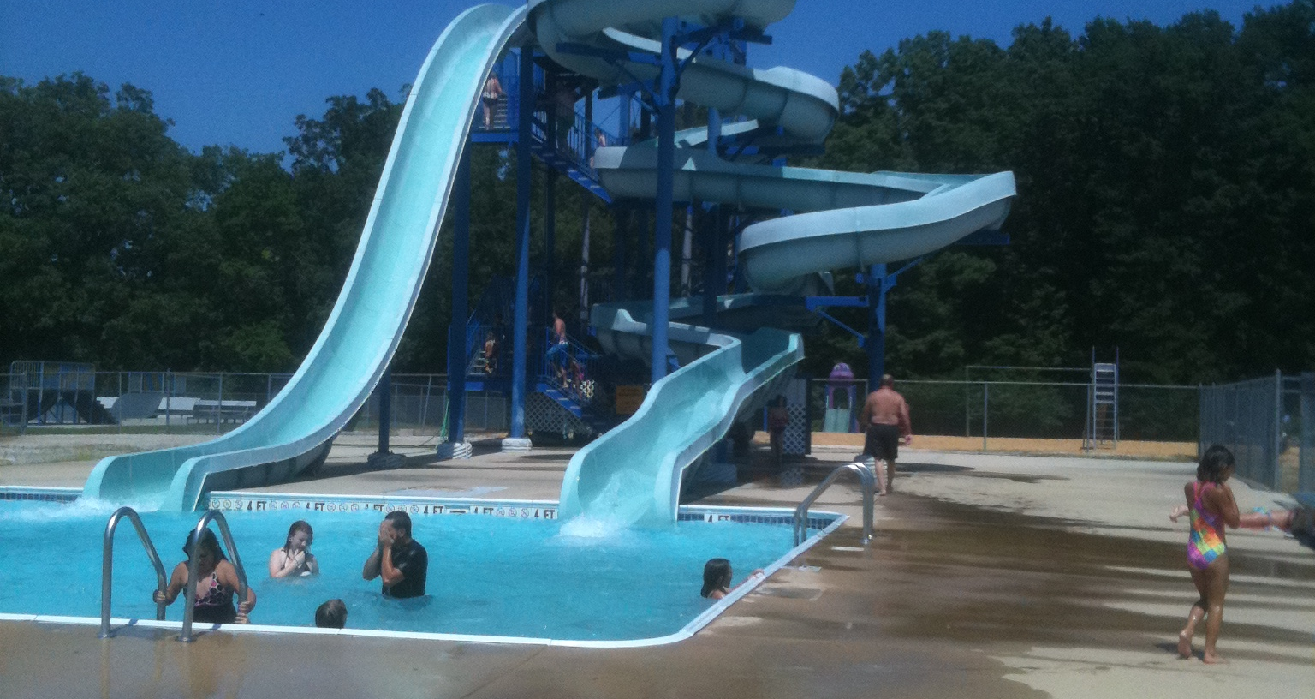
Safety Rules
Notes:
Large Waterslides should have clearly posted rules at the bottom and top of the slide. These rules should address cautions and limitations for individuals, swimming ability, no multiple riders, and proper sliding positions such as feet first, required age or height.
Pool operators should refer to the manufacturer’s recommended rules as a basis for the slide rules such as age or height requirements. Example I’ve seen a few signs that state: Due to manufacturer’s guidelines , patrons must be at least 48 inches to ride the slide. Problem was the rules were not enforced.

Slide 56
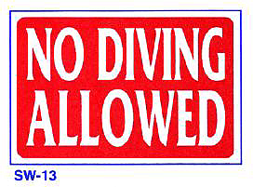
Pool Inspection
Aquatic facility staff should inspect and protect the facility.
Inspect signage and safety rules
Water slides, diving boards, ladders
Entrapment prevention
Life saving equipment
Notes:
Slip and fall accidents happen frequently at swimming pools - Regular inspections of the deck, bathrooms, showers, locker rooms should help minimize these type of accidents.
Other pool items to inspect include the pumps, submerged lights, GFI outlets, and Buoy lines
Buoy lines should be in place to mark physical and visual boundaries of the deeper pool areas but they are also in place to assist tired swimmers. Buoy lines should be inspected often for fraying, to check floats for holes or cracking, and also to ensure the line isn’t overly stretched.
These large water slides should be inspected everyday for proper signage and safety rules, rough spots, abnormal conditions, and loose bolts handrails etc. and like everything else all inspections should be documented.
We also need to have an annual inspection from an outside agency to have a thorough inspection to see if there is any corrosion in the slide, to check the condition of the joints between the plastic sections, all bolts are secure, and test the strength of the runway foundations and pillars to ensure they are sufficient.

Slide 57

Regulations
The Virginia Graeme Baker Act is intended to prevent suction entrapment and entanglement in pools and spas.
Notes:
Federal requirement from 2008. All operating public pools and spas must have a drain cover of any size and shape that a human body cannot block to create a suction entrapment hazard.” Check and make sure that your in compliance with this requirement. Drain Covers should be inspected daily. If any drain covers or anti vortex plates are missing or broken, the pool should be closed until the repair is complete.
If the pool has a single main drain or suction outlet (other than an unblockable suction outlet), the operator must install a second anti-entrapment device or system, such as an automatic pump shut-off system or Safety Vacuum Release System (SVRS). Consult the consumer product safety commission for more information
Another regulatory issue to be concerned with is the ADA requirements that are now in effect. Public pools less than 300 linear feet in perimeter should have at least one means of entry for disabled individuals. More than 300 ft needs two methods of access.
Means of access include pool lifts and sloped entries as outlined in the ADA standards. Please check the Dept. of Justice website www.ada.gov for more information. Sections 242 and 1009 cover pools spas wading pools.

Slide 58
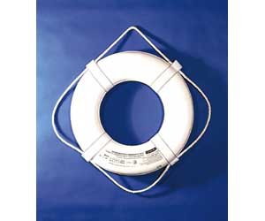
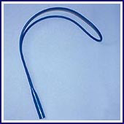
Life Saving Equipment
Notes:
Life saving equipment such as Backboards should be clearly displayed and accessible to lifeguards. Inspect to ensure that the head immobilizers are firmly secured to the board.
A ring buoy with a rope and a shepherd’s crook or body hook should be visible and in good condition.

Slide 59
Lifeguards
Lifeguards represent your aquatics facility. Lifeguards perform many tasks such as:
Prevent accidents and injuries
Enforce rules
Provide rescue and emergency care when needed
Notes:
Lifeguards also perform many other tasks such as cleaning, providing swimming lessons, checking the water quality, greeting the public but there main job is preventing accidents and responding when an incident does occur.
Lifeguards must be prepared, focused, and ready at all times to make a quick rescue or a quick response to a situation. Therefore when they are supervising the pool that is their only job at that time.
Lifeguards should be certified in lifeguard training, CPR, and first aid. All records should be on file with the employer.
Lifeguards must train regularly to maintain their skills and have an understanding your emergency action plan and all safety rules.
Emergency action plan should cover
Lightning/tornado or any weather event, medical emergencies-stroke heart attack ect, chemical spills, missing child, evacuation of the pool.
Keep in mind that every detail concerning pool safety hasn’t been covered in this short amount of time. It is recommended that pool managers complete a training program such as certified pool operator or aquatics facility operator to ensure he or she has the proper knowledge to reduce liability exposures and more importantly provide a safe facility.

Slide 60
Skateboard Parks
Was the skateboard park designed and installed by a professional contractor?
Is the proper signage installed?
Do you have a documented skateboard park inspection?
Notes:
Its best to have fencing, hours posted closed at dusk or provide lighting, rules posted, and of course inspected.

Slide 61
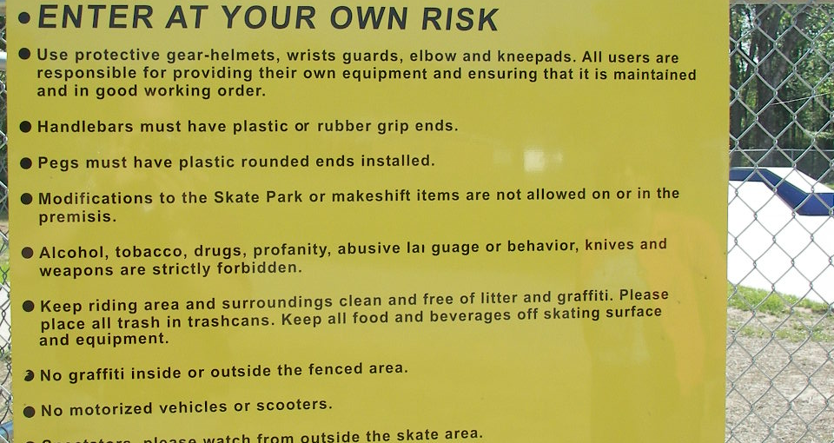
Skateboard Park Signage
Notes:
The only thing that is different is required signage at the skateboard parks and the equestrian areas. This signage is required by The Code of Alabama Section 6-5-342 for skating facilities and section 6-5-337 for equestrian areas.

Slide 62
Section 6-5-342
"WARNING
Under Alabama law, a skateboard or roller skating park or rink operator is not liable for injury, damages, or death of a participant, assistant, or spectator in skateboarding or roller skating activities in the park or rink resulting from the inherent risks of skateboarding or roller skating activities. If skateboarding is permitted in this facility, any person skateboarding in this facility must wear appropriate protective equipment including a helmet, elbow pads, and knee pads."
Notes:
A handout is included and can also be found on our website.

Slide 63
Section 6-5-342
Every operator of a skateboard or roller skating park or rink shall post and maintain a warning sign in a clearly visible location at the entrance of the park or rink and any other conspicuous location within the park or rink as specified in this section. The sign shall serve as a warning to the roller skaters, skateboarders, assistants, spectators, and any others involved in this activity that the operator of the park or rink has limited civil liability under Alabama law for skateboarding and roller skating activities occurring at the park or rink. Failure to comply with the requirements concerning warning signs provided in this section shall prevent an operator of a park or rink from invoking the privileges of immunity provided by this section. The warning notice shall appear on the sign in black letters with each letter to be a minimum of one inch in height and shall contain the following notice:
Notes:
Courts have said that is there is a specific statute for a specific activity such as this, and you don’t comply then cant just fall back on a more general statute such as the immunity statute.

Slide 64
Section 6-5-337
The Code of Alabama Section 6-5-337 regarding Equine Activities. The warning notice should appear on a sign in black letters with each letter to be a minimum of one inch in height and shall contain the following notice:
"WARNING: Under Alabama law, an equine activity sponsor or equine professional is not liable for an injury to or the death of a participant in equine activities resulting from the inherent risks of equine activities, pursuant to the Equine Activities Liability Protection Act."
Notes:
Equestrian signage If you have an arena, stables, a horse show, riding trails or anything of this nature you must have this sign posted to invoke the privileges of immunity provided by this statute.

Slide 65
Questions?

